Slide 1


FY2026 CONTINUUM OF CARE (COC) Program Competition
NY-513 Community Provider Information Session
Understanding the FY2026 HUD NOFO
Funding Opportunities • Local Competition • Rural Designation • Provider Guidance
Presented by FLACRA
Collaborative Applicant | NY-513 Finger Lakes Continuum of Care
https://www.flacra.org/coc-ny-513
July 7, 2026
This presentation provides a high-level overview of the FY2026 Continuum of Care (CoC) Program Competition and the NY-513 local competition process. It is intended to supplement—not replace—the FY2026 HUD NOFO, applicable federal regulations, and the NY-513 Competition Policies and Procedures.
NY-513 | Ontario • Seneca • Wayne • Yates Counties
Notes:
1

Slide 2
SESSION ROADMAP
Today’s Agenda
FY2026 NOFO Overview
Funding Opportunities
Purpose, funding, and timeline
Renewals, CoC Bonus, DV Bonus, planning, reallocation
What’s New in FY2026
Local Competition & Scoring
Policy changes, increased competition, provider strategies
Scoring, ranking, priority listing, submissions & appeals
NY-513 Rural Designation
Preparing a Competitive Application
Why we qualify, opportunities, and what it means
Best practices, common mistakes, special circumstances
NY-513 Continuum of Care | Serving Ontario, Seneca, Wayne & Yates Counties
Notes:
2

Slide 3
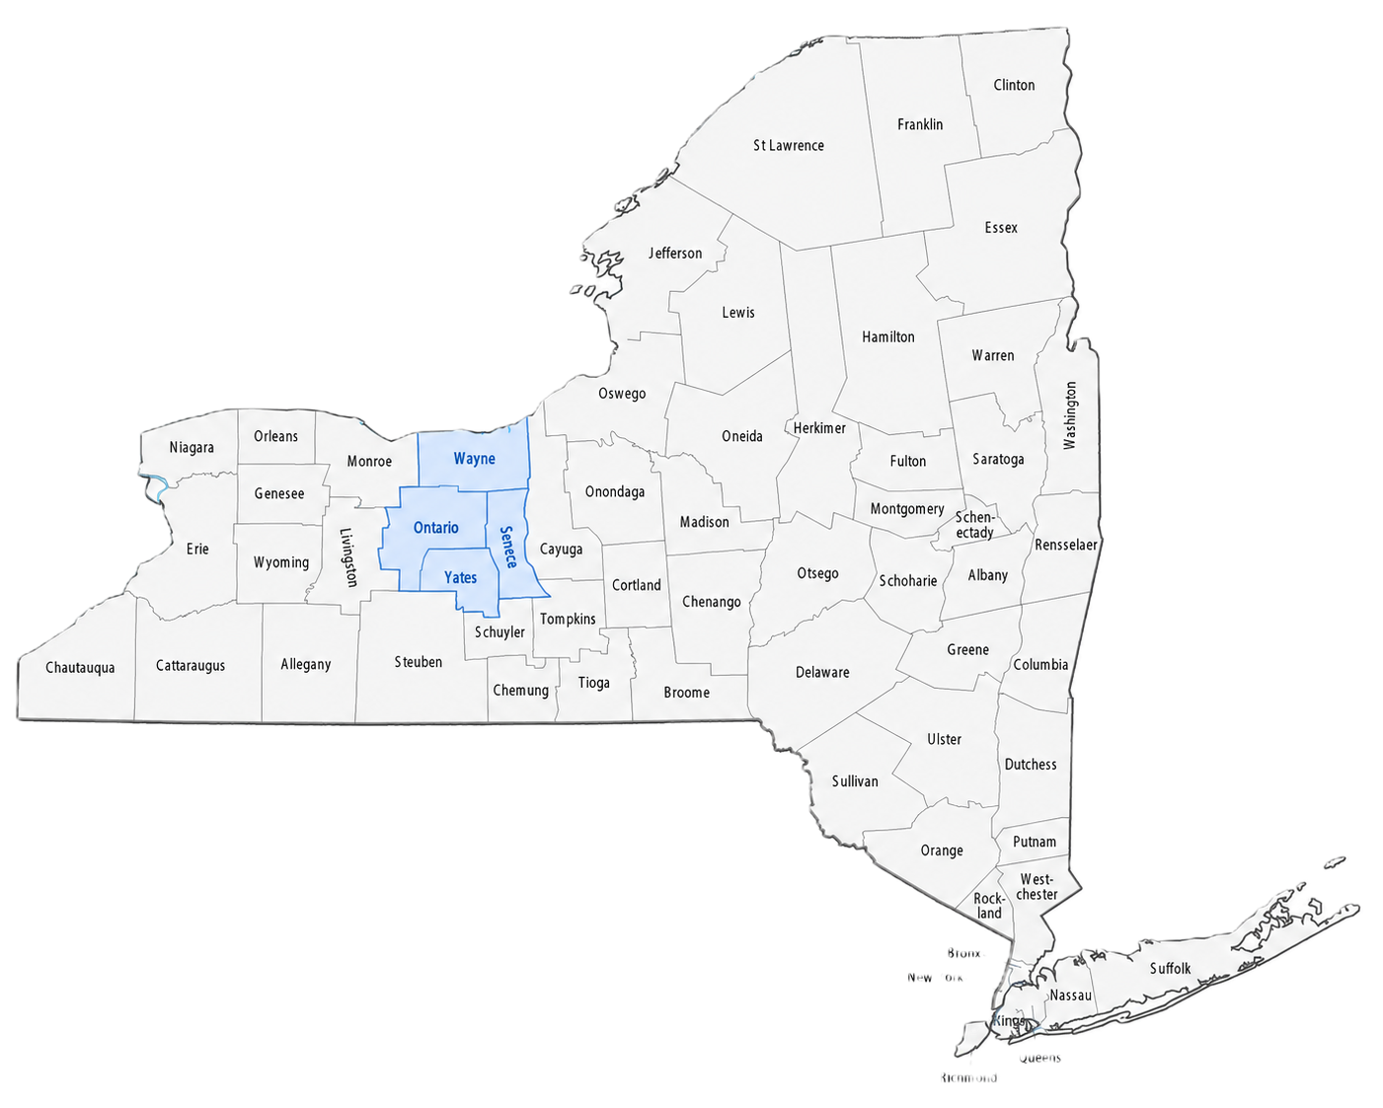
FY2026 NOFO OVERVIEW
Purpose of the CoC Program
The CoC is more than a funding opportunity. It is the community planning body that works with partners to identify local needs, establish funding priorities, and direct HUD resources toward projects with the greatest impact on reducing homelessness.
NY-513 Continuum of Care
What This Means for Providers
Serves Ontario, Seneca, Wayne, and Yates Counties
Develops a regional plan to prevent and end homelessness
Manages the annual HUD CoC Program funding competition
Oversees HMIS compliance, PIT Count, HIC, and system performance
Conduct annual Point-in-Time (PIT) Count and Housing Inventory Count (HIC)
Collects and analyzes system performance data
Identifies service and housing gaps and aligns resources
NY-513 Continuum of Care | Serving Ontario, Seneca, Wayne & Yates Counties
Notes:
3

Slide 4
NOFO FUNDING OVERVIEW
Funding Available in FY2026
$4.040 Billion Available Nationwide
Funding Sources
Eligible Project Types
National Highlights
Renewal Funding
CoC Bonus Funding
Domestic Violence Bonus Funding
Planning Grants
Reallocation / Transition Opportunities
Permanent Supportive Housing (PSH)
Rapid Re-Housing (RRH)
Transitional Housing (TH)
SSO – Standalone and Street Outreach
HMIS and Coordinated Entry
Not every CoC will receive full ARD
Planning Grants equal to 5% of FPRN
$104M reserved for DV Bonus projects
$430M reserved for Permanent Housing for families with children
HUD has not yet added recaptured funds to the total funding available.
NY-513 Continuum of Care | Serving Ontario, Seneca, Wayne & Yates Counties
Notes:
4

Slide 5
FUNDING
FY2026 NY-513 Local Funding Overview
Funding Component
Status
What This Means for Providers
Annual Renewal Demand (ARD)
Pending HUD release
Although HUD has not yet released NY-513 funding amounts, providers should begin preparing now. Strong performance, measurable outcomes, and well-developed narratives will be essential in this year’s competition.
Final Pro Rata Need (FPRN)
Pending HUD release
CoC Bonus
Pending HUD release
Planning Grant
5% of Final Pro Rata Need
Domestic Violence Bonus
National competition
Tier 1: 60% of ARD
Tier 2: 40% of ARD
  First 60% of Annual Renewal Demand
  Generally expected to be funded if threshold requirements are met and HUD approves
Competes nationally based on local ranking, HUD merit review, risk assessment, and funding availability
NY-513 Continuum of Care | Serving Ontario, Seneca, Wayne & Yates Counties
Notes:
5

Slide 6
KEY DATES
FY2026 Competition Timeline
Date
Milestone
June 1, 2026
HUD releases FY2026 CoC NOFO
June 30, 2026
NY-513 local competition opens
July 7, 2026
Community provider information session
July 15, 2026
New project applications due
July 23, 2026
CoC Rank and Review
July 31, 2026 – 5:00 PM
Final project ranking determined
August 10, 2026 – 12:00 PM
Appeal deadline
August 11, 2026 – 5:00 PM
Project applications entered into eSnaps
August 18, 2026 – 8:00 PM
Priority Listing & Application posted for public review (Public Comment Deadline: August 20, 2026)
August 21, 2026 – 8:00 PM
Final Priority Listing posted
August 25, 2026 – 12:00 PM
NY-513 submission target
August 26, 2026 – 8:00 PM ET
HUD CoC Consolidated Application due
December 1, 2026
Anticipated HUD award announcement
NY-513 Continuum of Care | Serving Ontario, Seneca, Wayne & Yates Counties
Notes:
6

Slide 7
POLICY CHANGES
What’s New in FY2026
What’s New
Why It Matters
Tier 1 reduced from 90% to 60%
More renewal funding will compete nationally in Tier 2.
New CoC Bonus structure
NY-513 qualifies as an Unchanged CoC with a minimum $500,000 CoC Bonus.
Emphasis on self-sufficiency
Projects should demonstrate long-term housing stability and independence.
New national priorities
More focus on treatment, service participation, public safety, and organizational capacity.
Expanded funding opportunities
Greater emphasis on TH, SSO, and Permanent Housing for families.
Rural provisions continue
Eligible rural CoCs, including NY-513, have additional opportunities under the FY2026 NOFO.
NY-513 Continuum of Care | Serving Ontario, Seneca, Wayne & Yates Counties
Notes:
7

Slide 8
INCREASED COMPETITION
Why FY2026 Is More Competitive
Tier 1 Reduced
All Projects Ranked
HUD Merit Review
Tier 1 has been reduced from 90% to 60% of the CoC's Annual Renewal Demand (ARD).
A larger share of renewal funding is now placed in Tier 2 and subject to national competition.
All project applications (except the CoC Planning Grant) must be reviewed, scored, and ranked by the CoC.
Local project ranking now plays an even greater role in funding decisions.
Tier 2 projects are evaluated based on:
Project eligibility and threshold compliance
HUD Risk Review
CoC Merit Review Score
Local Project Ranking
Availability of funding
NY-513 Continuum of Care | Serving Ontario, Seneca, Wayne & Yates Counties
Notes:
8

Slide 9
WHAT STRONG APPLICANTS SHOULD DO
Provider Strategies
01
Demonstrate measurable outcomes
02
Maintain strong HMIS data quality
03
Clearly document community need
04
Align with HUD priorities
05
Tell a compelling story
06
Submit complete applications
Start early. Tell the need clearly. Prove the impact.
NY-513 Continuum of Care | Serving Ontario, Seneca, Wayne & Yates Counties
Notes:
9

Slide 10
WHY OUR COC QUALIFIES
NY-513 Rural Designation
What Changed
NY-513 Qualifies
NY-513 Counties
The FY2026 CoC NOFO includes special provisions for eligible rural Continuums of Care.
Although NY-513 includes both rural and non-rural counties, HUD has determined that the Continuum qualifies under the FY2026 rural provisions.
Ontario County
Seneca County
Wayne County
Yates County
Our rural designation allows NY-513 to compete for funding opportunities and eligible project types that may not otherwise be available under the standard CoC competition.
NY-513 Continuum of Care | Serving Ontario, Seneca, Wayne & Yates Counties
Notes:
10

Slide 11
ADDITIONAL FLEXIBILITY
Rural Designation Opportunities
Limited affordable housing
Longer travel distances
Limited public transportation
Workforce shortages
Fewer behavioral health and supportive service providers
Eligible rural CoCs may benefit from
Rural challenges HUD recognizes
Expanded eligible project types
Increased flexibility in project design
Recognition of rural housing and service challenges
Opportunities to address transportation barriers
Greater emphasis on dispersed communities
Consideration of limited housing resources
HUD recognizes that rural homelessness often looks different than homelessness in urban areas. The FY2026 NOFO acknowledges these differences by providing additional flexibility for eligible rural CoCs.
NY-513 Continuum of Care | Serving Ontario, Seneca, Wayne & Yates Counties
Notes:
11

Slide 12
WHAT RURAL DESIGNATION MEANS
How Providers Can Strengthen Applications
When appropriate, describe how your project:
Transportation
Housing shortages
  Addresses barriers unique to rural communities
  Expands access to housing and supportive services
  Improves coordination across the four-county region
  Uses partnerships to overcome transportation and workforce challenges
  Demonstrates community need with local data
  Aligns with HUD and NY-513 strategic priorities
Workforce shortages
Geographic isolation
Broadband access
Partnerships
NY-513 Continuum of Care | Serving Ontario, Seneca, Wayne & Yates Counties
Notes:
12

Slide 13
Which Opportunity Is Right for Your Organization
FY2026 Funding Opportunities
Funding Opportunity | Purpose | Who Should Consider Applying?
Renewal Projects | Continue existing CoC-funded projects | Current CoC recipients
CoC Bonus | New permanent housing and eligible projects | Organizations proposing new projects aligned with HUD priorities
Domestic Violence (DV) Bonus | Expand housing and services for survivors | Domestic violence providers and eligible partners
Planning Grant | Supports CoC planning and administration | Collaborative Applicant (NY-513)
Reallocation | Redirect funding to higher-priority projects | Current recipients considering project redesign
FY2026 local funding amounts, including the Annual Renewal Demand (ARD) and CoC Bonus allocation, will be incorporated into the NY-513 competition once released by HUD.
NY-513 Continuum of Care | Serving Ontario, Seneca, Wayne & Yates Counties
Notes:
12

Slide 14
LOCAL COMPETITION & SCORING
Local Competition & Scoring
Every eligible project is evaluated using
HUD threshold requirements
Local application completeness
Performance outcomes
HMIS data quality
Financial and organizational capacity
Alignment with HUD priorities
Alignment with NY-513 priorities
Important reminder
Meeting HUD threshold requirements does not guarantee funding. Projects must also perform well in the local competition.
NY-513 Continuum of Care | Serving Ontario, Seneca, Wayne & Yates Counties
Notes:
14

Slide 15
LOCAL COMPETITION & SCORING
Project Ranking Process
Application Submitted
Eligibility Review
Review Committee
Application Scored
Projects Ranked
Priority Listing Developed
Board Approval
HUD Submission
NY-513 Continuum of Care | Serving Ontario, Seneca, Wayne & Yates Counties
Notes:
15

Slide 16
LOCAL COMPETITION & SCORING
What Is the Priority Listing?
Priority Listing definition
The Priority Listing
The Priority Listing is the official list of all projects submitted to HUD in rank order. A project’s ranking may influence its competitiveness, particularly for Tier 2 funding.
Reflects results of the local competition
Includes renewal and new project applications
Is approved through NY-513 governance
Is posted publicly for review before submission
Is submitted as part of the Consolidated Application
NY-513 Continuum of Care | Serving Ontario, Seneca, Wayne & Yates Counties
Notes:
16

Slide 17
LOCAL COMPETITION DECISIONS
Appeals Process
  Local project ranking
  Local competition decisions
  Scoring concerns when applicable
  Other determinations outlined in NY-513 policies
  Appeals must follow NY-513 procedures
  An appeal does not automatically change ranking
  Final rankings are reflected in the Priority Listing submitted to HUD
Applicants may appeal
Important information
Appeals must be submitted according to the NY-513 Competition Policies and Procedures.
Appeals will be reviewed in accordance with the established local process.
Applicants will be notified of the final determination before submission of the Priority Listing to HUD.
Appeal Deadline: August 10, 2026 – 12:00 PM
NY-513 Continuum of Care | Serving Ontario, Seneca, Wayne & Yates Counties
Notes:
17

Slide 18
BEST PRACTICES
Preparing a Competitive Application
  Read the NOFO carefully
  Review local application instructions
  Demonstrate measurable outcomes
  Ensure HMIS data is accurate
  Provide all required attachments
  Meet every local deadline
  Respond promptly to clarification requests
Instead of focusing on points, talk about qualities:
Demonstrates documented community need.
Aligns with HUD and NY-513 priorities.
Shows measurable outcomes.
Uses strong partnerships.
Has sound financial and programmatic capacity.
Submits a complete and timely application.
Before you submit
Strong applications show
The strongest applications clearly demonstrate community need, measurable impact, organizational capacity, and alignment with HUD and NY-513 priorities.
NY-513 Continuum of Care | Serving Ontario, Seneca, Wayne & Yates Counties
Notes:
18

Slide 19
APPLICATION QUALITY CHECK
Common Mistakes and How to Avoid Them
Common Mistake
How to Avoid It
Waiting until the last minute
Start early and allow time for review and revisions.
Not aligning with priorities
Explain how the project supports HUD and NY-513 priorities.
Weak project narratives
Use local data, describe need, and explain expected outcomes.
Incomplete materials
Review requirements, submit all attachments, and proofread.
Poor HMIS or performance data
Regularly review data quality reports and validate measures.
Missing deadlines or follow-ups
Monitor communications and respond promptly to clarification requests.
NY-513 Continuum of Care | Serving Ontario, Seneca, Wayne & Yates Counties
Notes:
19

Slide 20
SOLO APPLICANTS
Special Application Circumstances
Most organizations should apply locally
A solo application may be submitted if
Most organizations should apply through the NY-513 local competition. HUD regulations allow direct solo applications only under limited circumstances.
The organization attempted to participate in the local CoC planning process
The organization believes it was not permitted to participate in a reasonable manner under 24 CFR 578.35
Important Requirements:
A written Notice of Intent to Appeal must be submitted with the HUD application.
Additional supporting documentation must be submitted to HUD after awards are announced, following the process outlined in 24 CFR 578.35.
The Collaborative Applicant (NY-513) is provided an opportunity to respond as part of HUD's appeal process.
NY-513 Continuum of Care | Serving Ontario, Seneca, Wayne & Yates Counties
Notes:
20

Slide 21
FY2026 COMPETITION
Key Takeaways
✓
Competition will be more competitive.
✓
NY-513 qualifies under the rural provisions.
✓
Strong project performance matters.
✓
Begin preparing applications early.
✓
Meet all local deadlines.
✓
Reach out early with questions.
NY-513 Continuum of Care | Serving Ontario, Seneca, Wayne & Yates Counties
Notes:
21

Slide 22
Questions?
Stay updated: Visit www.flacra.org/coc-ny-513
NY-513 Continuum of Care | Serving Ontario, Seneca, Wayne & Yates Counties
Notes:
22

