Slide 1

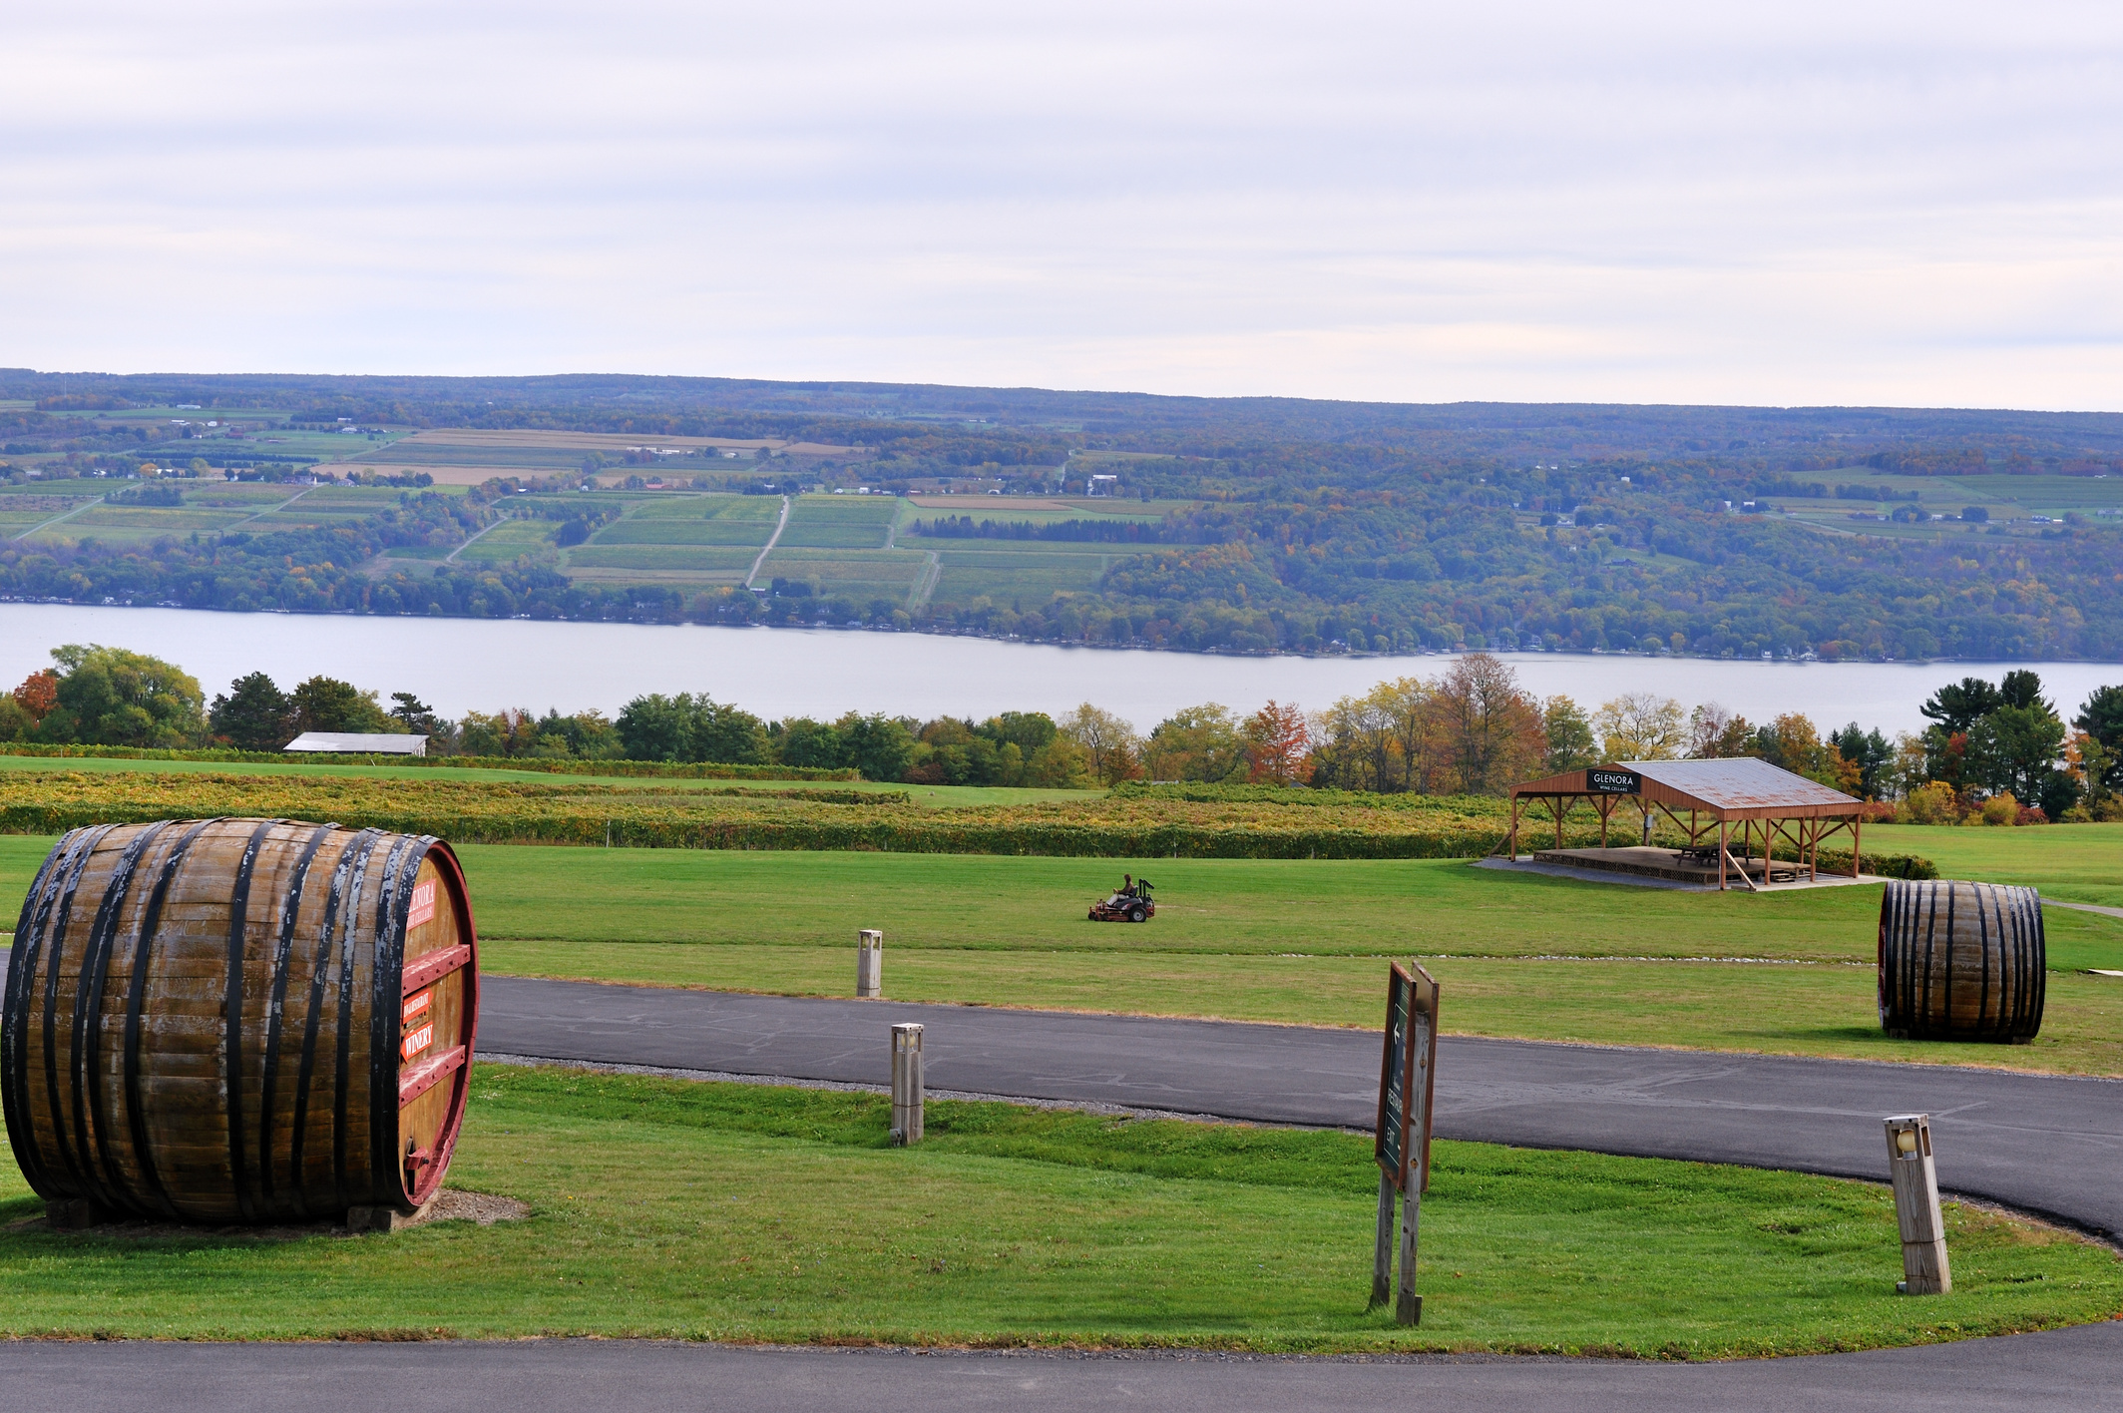




NY-513
Ontario, Seneca, Wayne, and Yates County
ANNUAL PRESENTATION
08/22/2025
Presented By: FLACRA
https://www.flacra.org/coc-ny-513

Slide 2
Grant Funding Overview
(Current Year)
Grant | Term | Total Awarded | Total Drawn | Remaining
HMIS | 12/1/2024-1/31/2026 | $21,185.00 | $7,474.00 | $13,710.00
Wayne County PSH | 4/1/2024-1/31/2026 | $129,964.00 | $129,964.00 | $0.00
SPC PSH | 7/1/2024-1/31/2026 | $165,016.00 | $131,204.00 | $33,811.00
CoC Planning | 10/1/2024-1/31/2026 | $63,941.00 | $53,284.00 | $10,656.00
FLCAP TH | 6/1/2024-1/31/2026 | $48,123.00 | $48,123.00 | $0.00

Slide 3
Grant Funding Overview
(Current Year)

Slide 4
Grant Performance
Utilization Percentage
Grant | Term | Utilization (%)
Wayne County PSH | 4/1/2022-3/31/2023 | 93%
Wayne County PSH | 4/1/2023-3/31/2024 | 95%
SPC PSH | 6/1/2022-6/30/2023 | 75%
SPC PSH | 6/1/2023-6/30/2024 | 95%
FLCAP TH | 6/1/2022-5/31/2023 | 77%
FLCAP TH | 6/1/2023-5/31/2024 | NA

Slide 5
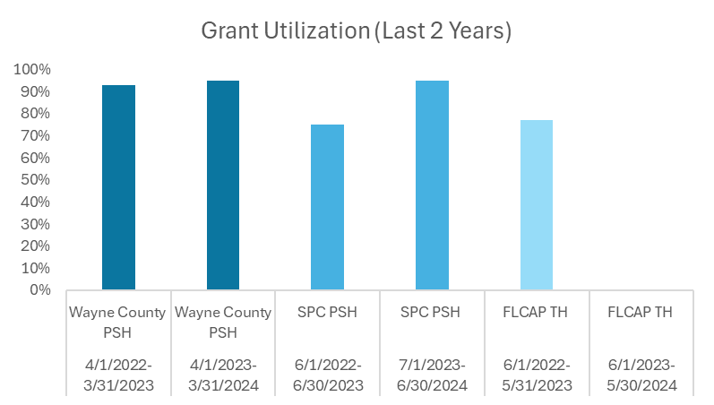
Grant Performance
Utilization Percentage

Slide 6
Grant Performance
Positive Housing Percentage
Grant | Term | Positive Housing (%)
Wayne County PSH | 4/1/2022-3/31/2023 | 84%
Wayne County PSH | 4/1/2023-3/31/2024 | 100%
SPC PSH | 6/1/2022-6/30/2023 | 91%
SPC PSH | 6/1/2023-6/30/2024 | 100%
FLCAP TH | 6/1/2022-5/31/2023 | 31%
FLCAP TH | 6/1/2023-5/31/2024 | 55%

Slide 7
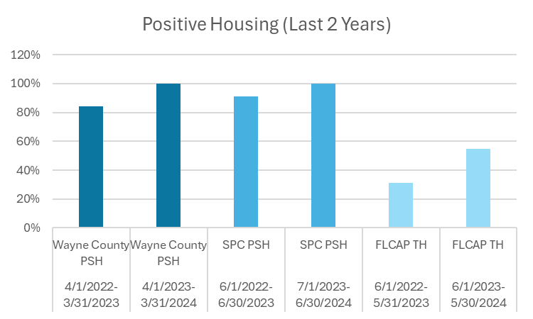
Grant Performance
Positive Housing Percentage

Slide 8





THANK YOU
https://www.flacra.org/coc-ny-513
(833) 435-2272
marketingandoutreach@flacra.org
@flacraNY

